Slide 1
Computer Networks
Prabhu Subramanian
prabhus@wilp.bits-pilani.ac.in

Slide 2
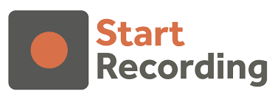
IMP Note to Self

Slide 3
Important Note to Students
It is important to know that just login to the session does not guarantee the attendance.
Once you join the session, continue till the end to consider you as present in the class.
IMPORTANTLY, you need to make the class more interactive by responding to Professors queries in the session.
Whenever Professor calls your number / name, you need to respond, otherwise it will be considered as ABSENT

Slide 4
SEWI ZC467 - COMPUTER NETWORKS
Lecture No. 08

Slide 5
Transport Layer
The transport layer is responsible for process-to-process delivery—the delivery of a datagram, part of a message, from one process to another.
Two processes communicate in a client/server relationship
Multiple processes running on each host (source as well as destination)
Need to uniquely address individual process running on each host
Communication involves:
  Local host
  Local process
  Remote host
  Remote process

Slide 6
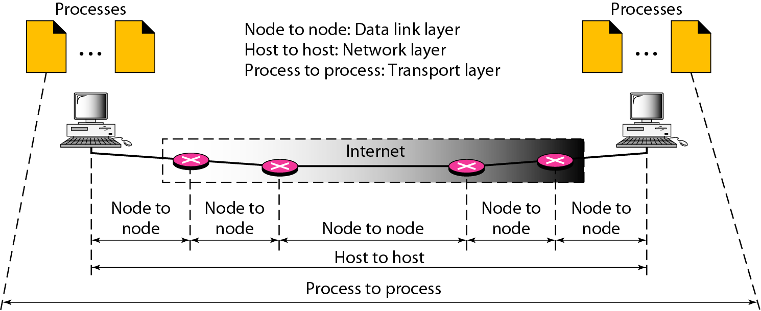
Types of Data Deliveries

Slide 7
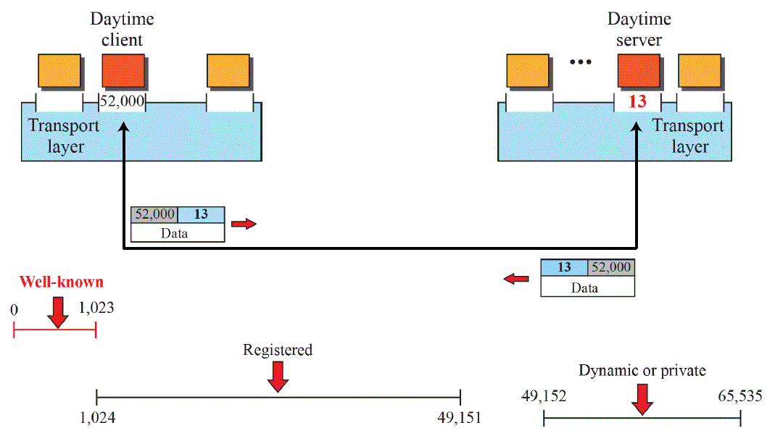
Port Numbers for Addressing
Internet Assigned Numbers Authority (IANA)
Well-known ports: Assigned and controlled by lANA
Registered ports : Not assigned or controlled by lANA
Dynamic ports : Neither controlled nor registered; Can be used by any process

Slide 8
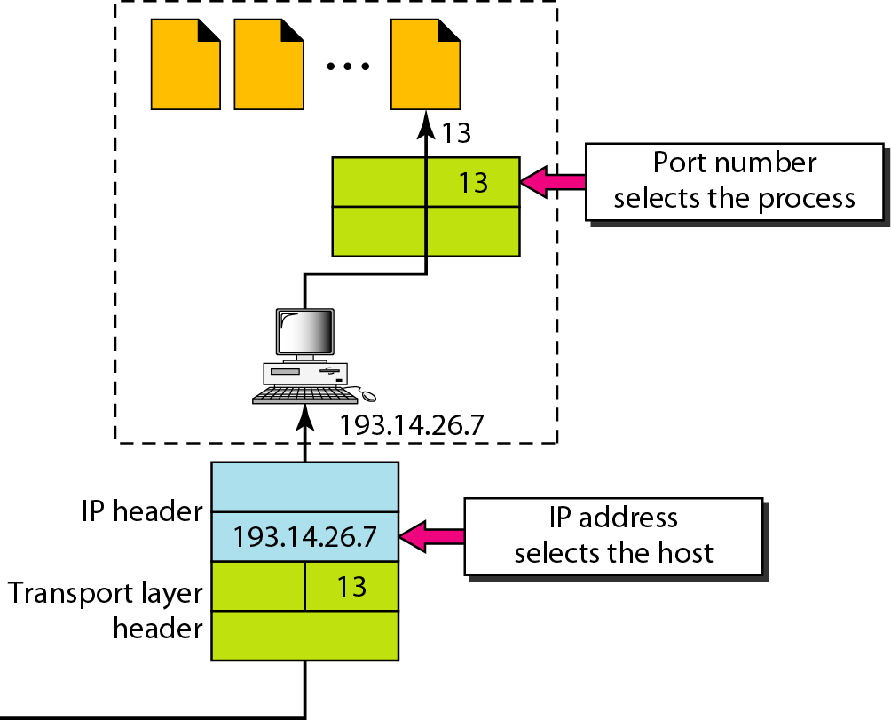
IP addresses versus port numbers

Slide 9
Transport Layer Protocols
The Internet model has three protocols at the transport layer: User Datagram Protocol (UDP), Transmission Control Protocol (TCP), and Stream Control Transmission Protocol (SCTP)
https://www.ionos.com/digitalguide/server/know-how/tcp-ports-and-udp-ports/
A few common UDP applications and their ports:
  daytime 13
  SUNRPC 111
  SNMP 161
  DOMAIN: 53
A few common TCP applications and their ports:
  HTTP 80
  HTTPS 443
  FTP 21
  SSH (Secure Shell) 22
  Telnet 23 and many more…
SCTP(Stream Control Transmission Protocol) is mainly used for signaling and transmission in telecommunications and specialized network applications

Slide 10
UDP
“bare bones” Internet transport protocol
“best effort” service, UDP segments may be lost or delivered out of order to application
Why is there an UDP Protocol?
No connection establishment (which can add to delay)
Simple – no connection state to be maintained at sender or receiver
Small segment header
No congestion control
No acknowledgements or retransmissions
- can blast away as fast as desired
For reliable transfer over UDP, add reliability at the application layer
(eg. Use of sequence numbers at application layer for ordering)

Slide 11
TCP vs UDP
Connection Type:
  TCP: Connection-oriented - establishes a connection before data transfer
  UDP: Connectionless - sends data without setting up a connection
Reliability:
  TCP: Reliable - ensures data is received correctly and in order using acknowledgments and retransmissions
  UDP: Unreliable - does not check for lost packets nor ensures order
Data Transmission Method:
  TCP: Sends data in continuous stream with mechanisms for congestion control
  UDP: Sends discrete packets (datagrams) without tracking order
Speed:
  TCP: Slower due to error-checking and retransmissions
  UDP: Faster because it lacks error-checking and connection setup

Slide 12
Why TCP not suitable for multimedia apps?
High Latency due to Reliability Mechanisms
  Acknowledgments (ACKs) and retransmissions for lost packets increases latency for TCP, while multimedia apps prioritize timely delivery over accuracy
  Retransmissions may cause inconsistency in delivery times
Head-of-Line Blocking
  TCP delivers data in order - if a packet is lost, subsequent packets must wait until the lost one is retransmitted and received, causing interruptions and also jitter in real-time playback.
Variable Throughput
  TCP dynamically adjusts the transmission rate based on network congestion conditions (slow start, congestion avoidance etc.)
  Fluctuations in bandwidth undesirable for multimedia apps- leads to inconsistent media playback rates.
No support for multicasting
  Many multimedia applications, such as live streaming, benefit from multicast transmission, where data can be sent to multiple recipients simultaneously - TCP inefficient for such cases
Notes:
If the network gets congested, TCP slows down, creating uneven data flow.

Slide 13
TCP vs UDP – Use Cases
Multimedia applications often prefer protocols that minimize overhead, thereby increasing bandwidth consumption - UDP preferred
UDP is faster, has lower latency, and does not enforce packet order or retransmissions, allowing real-time applications to continue without interruptions and ensuring smoother playback, without jitters
UDP: Used for speed-critical applications, e.g., video streaming, online gaming, VoIP, and DNS queries.
TCP: Used for applications needing reliability, e.g., web browsing (HTTP/HTTPS), email (SMTP, IMAP), and file transfers (FTP)
Applications that require data be received in the correct order and without gaps.
TCP is best when accuracy matters, and UDP is ideal when speed is a priority.
Notes:
If the network gets congested, TCP slows down, creating uneven data flow.

Slide 14
Reliability Mechanisms
Data Link Layer provides error control mechanisms, is it needed at the transport layer too?
Yes, they serve different purposes and operate at different levels on the network stack
Data Link Layer provided local error control on per link basis, ensuring error-free delivery of frames between directly connected devices (node-to-node delivery)
- Deals with errors caused by physical error noise, bit corruption etc.
Transport Layer Mechanisms ensure error-free, complete and ordered delivery of data for end-to-end systems
- Deals with errors caused due to packet loss in routers and switches, packet reordering due to network congestion etc.
.
Similarly, flow control mechanisms are implemented at both layers, using the sliding window
Notes:
If the network gets congested, TCP slows down, creating uneven data flow.

Slide 15
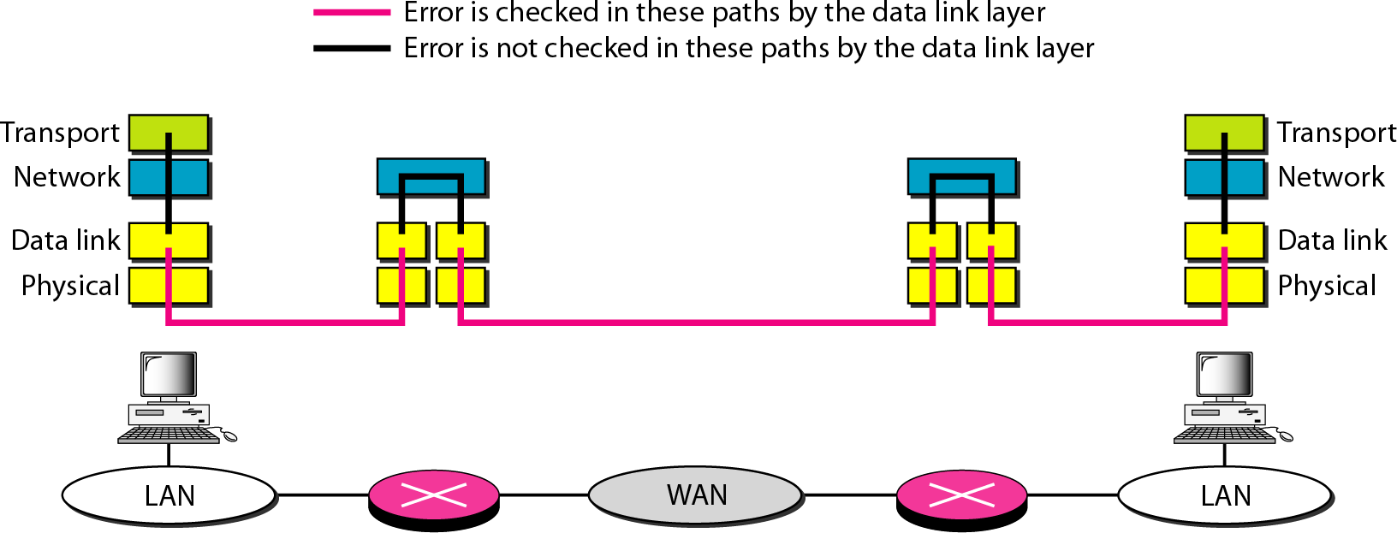
Error control: Layered Approach

Slide 16
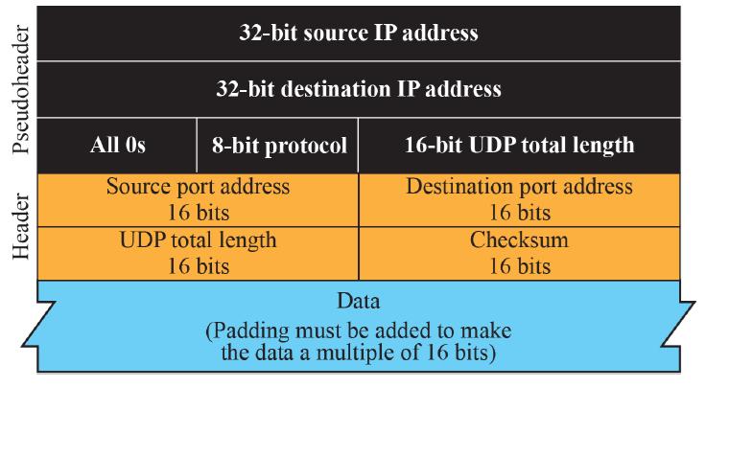
UDP Header Format
(including pseudo header)
UDP Header: 8 bytes
Total length field (includes both header and payload of UDP packet), same in pseudo-header
Checksum computation involves pseudo-header, header and data
Notes:
If the network gets congested, TCP slows down, creating uneven data flow.

Slide 17
Pseudo-header – Why needed?
Pseudo-header: A temporary structure used for checksum calculation
Includes critical IP layer information (like source & destination IP addresses)
to ensure correctness of IP addresses thereby preventing delivery to wrong destinations
Includes length field to ensure that correct amount of data is verified
Also having both Transport Layer and IP layer Checksums not redundant
Scope of checksum different
IP layer may have fragments - checksum on the fragments
Notes:
If the network gets congested, TCP slows down, creating uneven data flow.

Slide 18
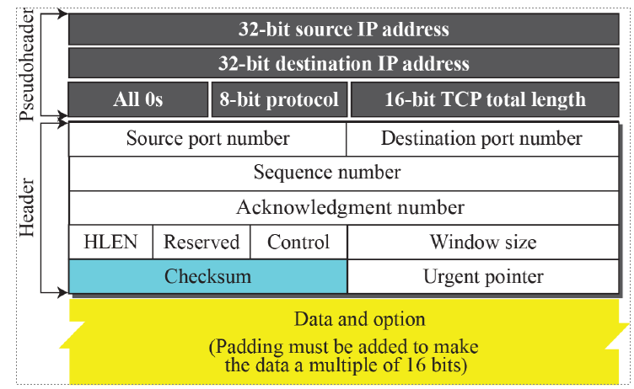
TCP Header Format
(including pseudo header)
TCP Header: 20 to 60 bytes – variable options field
Notes:
If the network gets congested, TCP slows down, creating uneven data flow.

Slide 19
TCP Header Options
TCP Header is 20 bytes without Options, upto 60 bytes including options
Options are variable length fields, each specified by its kind(bytecode) & length
Two common header options are: MSS and Window Scaling
MSS (Maximum Segment Size) - [Kind: 2, Length: 4]
  Largest amount of data a TCP segment can carry, excluding the TCP and IP headers, without causing local IP to fragment
  Default 536 bytes for IPv4, most Ethernet networks allow 1460 bytes
  Specified as a TCP option, initially in the TCP SYN packet during the TCP handshake
  Host can change in later segment also
Window Scale - [Kind: 3, Length: 3]
  Allows TCP window sizes to exceed beyond 65535 (16-bit limit in header)
  Useful for high speed networks
  Effective Window Size = Advertised Window Size X 2 ^{scaling factor}
Notes:
If the network gets congested, TCP slows down, creating uneven data flow.

Slide 20
Triggering Transmissions
What are the mechanisms used by TCP to trigger transmission ?
TCP has three mechanism to trigger the transmission of a segment
TCP maintains a variable MSS and sends a segment as soon as it has collected MSS bytes from the sending process
  MSS: MTU of directly connected network – (TCP header + IP header)
Sending process has explicitly asked TCP to send it
  TCP supports push operation (PUSH flag set)
When a timer fires
  Resulting segment contains as many bytes as are currently buffered for transmission
Notes:
If the network gets congested, TCP slows down, creating uneven data flow.

Slide 21
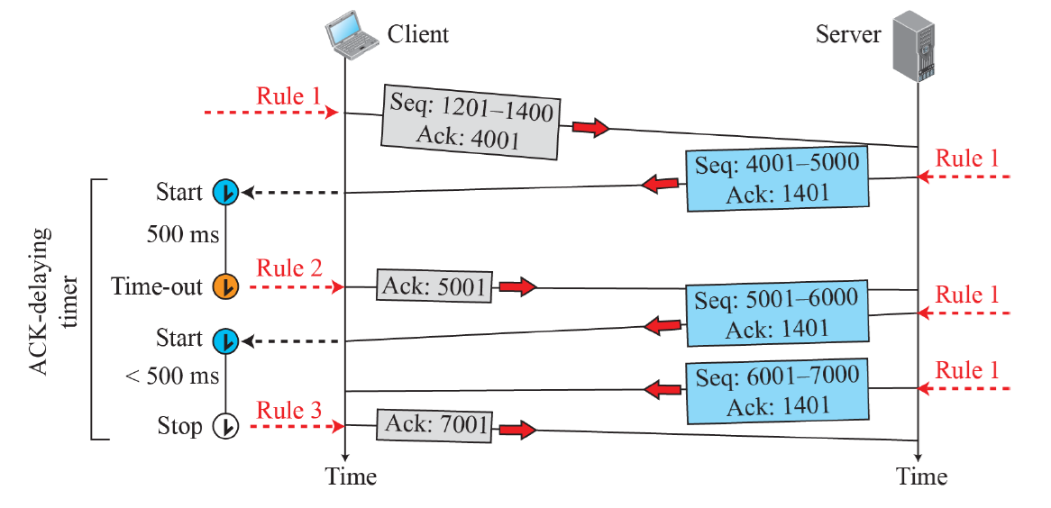
TCP: Go Back N or Selective Repeat
Normal Operation
Rule 1: Acknowledgement slightly delayed to piggyback data transmission
Rule 2: Acknowledgement sent when ACK delaying timer times out
Rule 3: One ACK sent normally for two received segments
Notes:
If the network gets congested, TCP slows down, creating uneven data flow.

Slide 22
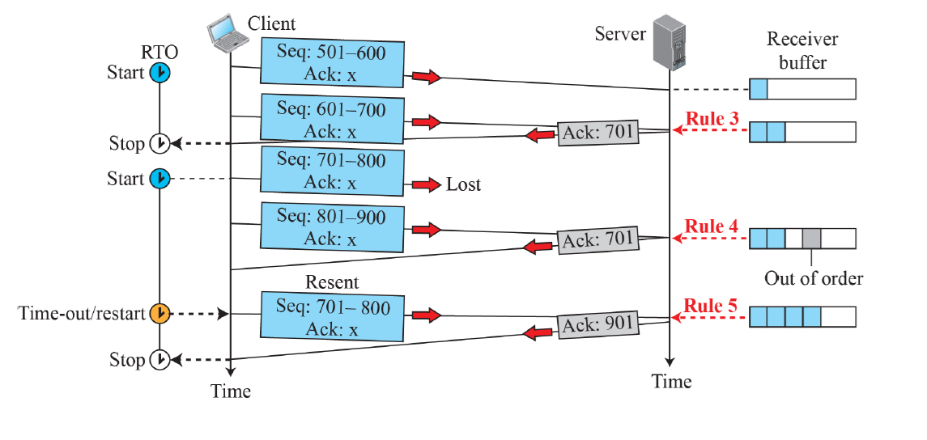
Contd..
Lost Segment
Rule 4: Acknowledgement sent when out of order detected, highest in-order received seq number (Normally, cumulative acknowledgement like Go Back N – ACK 3 if packets 1,2, 4 arrive)
Rule 5: ACK sent when out-of-order corrected
Notes:
If the network gets congested, TCP slows down, creating uneven data flow.

Slide 23
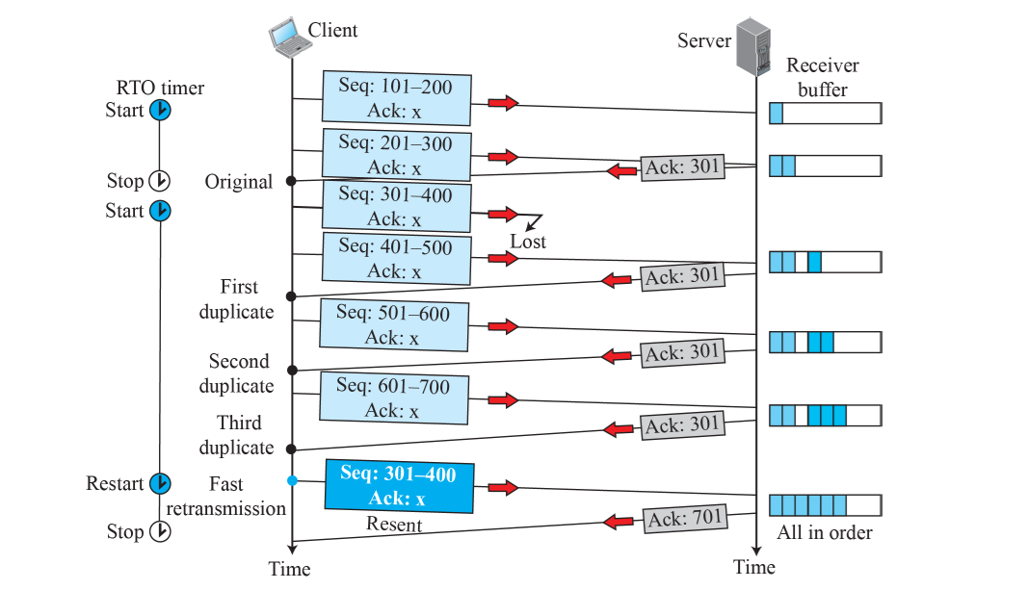
Contd..
Fast Retransmit (3 DUP ACKs)
Notes:
If the network gets congested, TCP slows down, creating uneven data flow.

Slide 24
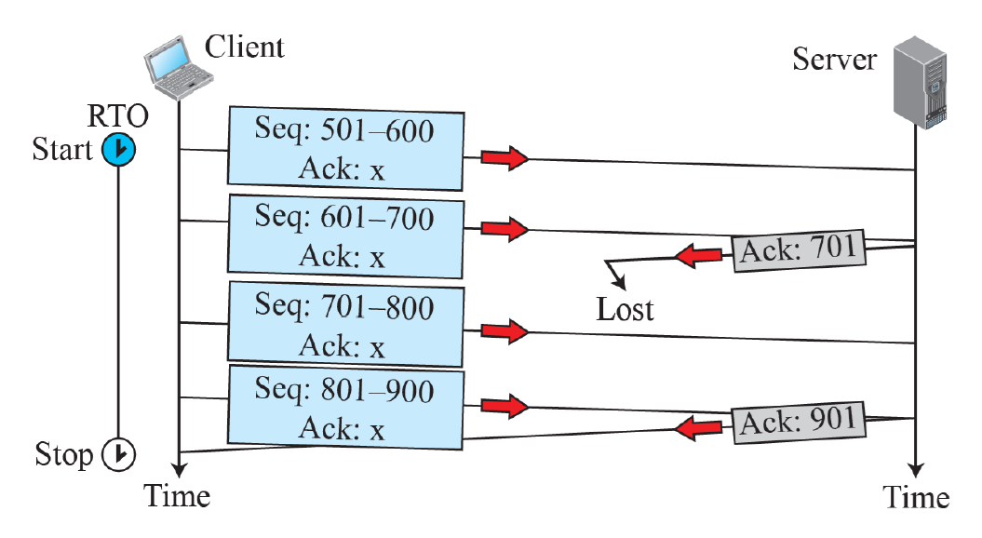
Contd..
Lost Acknowledgement : (automatically corrected by TCP when next segment arrives)
Notes:
If the network gets congested, TCP slows down, creating uneven data flow.

Slide 25
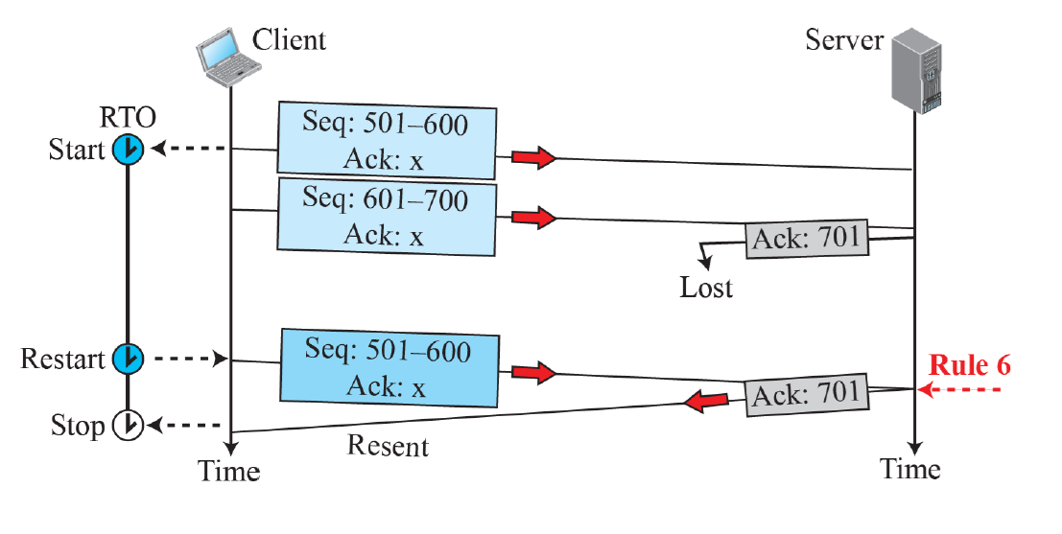
Contd..
Lost Acknowledgement (corrected by resending segment when timer expires)
Rule 6: When a duplicate data segment is received for which ACK already sent,
TCP simply resends the last ACK
Notes:
If the network gets congested, TCP slows down, creating uneven data flow.

Slide 26
Silly Window Syndrome (SWS)
What is Silly Window Syndrome? What are the causes of SWS ?
A performance issue in TCP flow control that occurs when small amounts of data are sent inefficiently, leading to excessive overhead and poor network performance (eg, 1 or 2 bytes of data with 20 bytes of header)
Can be caused by both sender and receiver
Receiver-induced SWS
  Receiver’s buffer fills up slowly
  Instead of waiting for more space to be freed up, receiver advertises a very small window size
Sender-induced SWS
  Sender send small segments of data, instead of waiting for more data to accumulate
  Often happens when an application generates data very slowly
Notes:
If the network gets congested, TCP slows down, creating uneven data flow.

Slide 27
Silly Window Syndrome (SWS)
How can SWS be prevented ?
Clark’s solution (Receiver-Side Fix)
  Receiver should avoid advertising small window size
  Should wait until enough buffer space is available (typically half the buffer size or 1 MSS)
Nagle’s algorithm (Sender-side fix)
  Sender should avoid sending small segments frequently
  Wait until either :
  There Is enough data to send a full-sized segment or
  Outstanding data acknowledged
Notes:
If the network gets congested, TCP slows down, creating uneven data flow.

Slide 28
Nagle’s Algorithm
When the application produces data to send
if both the available data and the window ≥ MSS
send a full segment
else
if there is unACKed data in flight
buffer the new data until an ACK arrives
else
send all the new data now
Notes:
If the network gets congested, TCP slows down, creating uneven data flow.

Slide 29
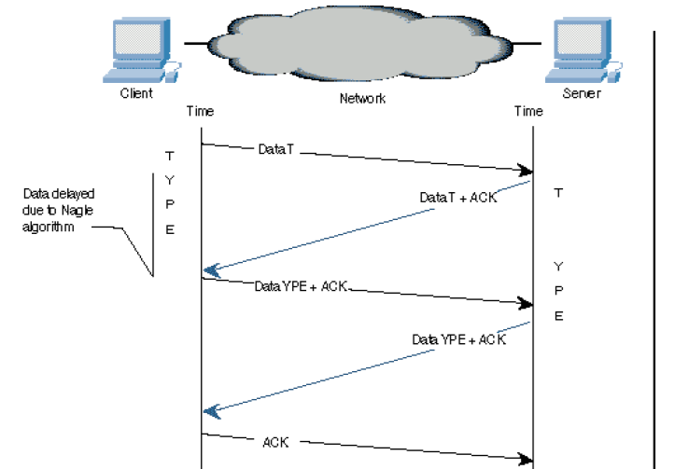
Nagle’s Algorithm for WAN Interactive Exchange
Telnet TYPE
Echo TYPE
Notes:
If the network gets congested, TCP slows down, creating uneven data flow.

Slide 30
Review Questions

Slide 31
TCP vs GBN
Mention one similarity and one difference between TCP and Go-Back-N protocols?
Similarity: Both use a sliding protocol for retransmission (both also use cumulative acknowledgement )
Difference: TCP has adaptive retransmission, whereas Go-Back-N retransmits all packets after a lost or erroneous packet, without adaptive retransmission
Notes:
If the network gets congested, TCP slows down, creating uneven data flow.

Slide 32
TCP vs Selective Repeat
Mention one similarity and one difference between TCP and Selective Repeat protocols?
Similarity: Both avoid unnecessary retransmissions, by retransmitting only lost segments
Difference: TCP (without SACK) acknowledges the highest in-order byte received i.e. does a cumulative acknowledgement, while Selective Repeat acknowledges individual packets, allowing sender to resend only lost packets without waiting further
[Note: TCP with SACK behaves similar to Selective Repeat by explicitly acknowledging missing packets]
Notes:
If the network gets congested, TCP slows down, creating uneven data flow.

Slide 33
If a sender sends 6 packets: packets 0, 1, 2, 3, 4, and 5. The sender receives an ACK with ackNo=3.
What is the interpretation if the system is using GBN or SR?
  If the system is using GBN, it means that packets 0, 1, and 2
  have been received uncorrupted and the receiver is expecting packet 3.
  If the system is using SR, it means that packet 3 has been received uncorrupted; the ACK does not say anything about other packets
Notes:
If the network gets congested, TCP slows down, creating uneven data flow.

Slide 34
In a client-server application that runs over UDP, the UDP server needs only one socket. If this application used TCP, the TCP server would need two sockets. Why? If the TCP server were to support n simultaneous connections, each from a different client host, how many sockets would the TCP server need?
  With the UDP server, there is no welcoming socket, and all data from different clients enters the server through this one socket
  With the TCP server, there is a welcoming socket, and each time a client initiates a connection to the server, a new socket is created. Thus, to support n simultaneous connections, the server would need n+1 sockets (1 welcoming socket and n connection sockets)
Notes:
If the network gets congested, TCP slows down, creating uneven data flow.

Slide 35
Consider a scenario where a user is using a System A with IP 192.168.1.50 on the Local Ethernet LAN which has its
  default router (R) set as 192.168.1.1
  a local DNS server (D) set as 192.168.1.99.
  Another server system B in the same LAN with IP 192.168.1.100
  runs the webserver at port 8080.
  It also has a domain name 'company.com' published in the local DNS server.
  Show the sequence of messages when the user at A, browses to
  URL : http://company.com:8080/
  HTTP + TCP + IP + DNS messages have to be shown
Notes:
If the network gets congested, TCP slows down, creating uneven data flow.

Slide 36
System A issues a DNS Query request to local DNS Server D 192.168.1.99
DNS 'A' record look up message
DNS Question: company.com
UDP : Source Port : 53 Dest Port : 53
IP Header: Source IP : 192.168.1.50 Dest IP: 192.168.1.99
2) Machine A opens a TCP connection to Machine B.
Sends a TCP SYN segment.
TCP: SYN bit -- Source Port : 5050 Dest Port: 8080
IP Header: Source IP : 192.168.1.50 Dest IP: 192.168.1.100
Machine B replies to the connection open request
TCP : SYN + ACK - Source Port: 8080 Dest Port: 5050
IP Header: Source IP : 192.168.1.100 Dest IP: 192.168.1.50
Notes:
If the network gets congested, TCP slows down, creating uneven data flow.

Slide 37
3) HTTP GET message as sent out by Machine A (along with final ACK)
GET / HTTP/1.1
Host: 192.168.1.100
User-Agent: Mozilla/5.0 Gecko/20100101 Firefox/23.0
Accept: text/html,application/xhtml+xml,application/xml;q=0.9,*/*;q=0.8
Accept-Language: en-US,en;q=0.5
Accept-Encoding: gzip, deflate
Connection: keep-alive
Notes:
If the network gets congested, TCP slows down, creating uneven data flow.

Slide 38
Thank You!

Slide 39
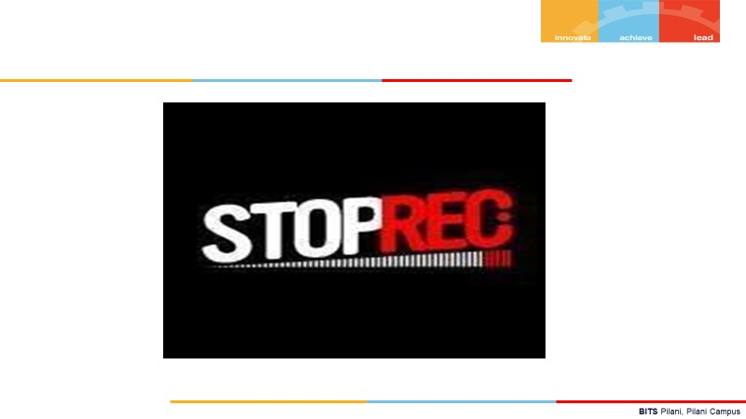
END the session before leaving

